Slide 1
TopiC: DESIGN OF A Solar Tracking System BASED ON Artificial Neural Networks
NAMES:
1. Rehema MWAWADO
2. Abidemi Matthew ORIMOGUNJE
3. Lasseni COULIBALLY
4. Onelia Fernanda CARIBO TRINDADE
5. Steven NSANZABANDI GASASIRA
Reg. Number and Program:
222023251 PhD ECS
222023250 PhD ECS
222023252 PhD ECS
222022597 PhD ECS
220014198 MSc. ECS

Slide 2
Team Organization
Name: Abidemi Orimogunje
Role : System Designer
Experience:System Designer
Reason: Strong Critical and analytical thinking and very adaptive to problem solving
Focused Area: Embedded architecture, Block diagram and PDL
Name: Lasseni COULIBALY
Role : programmer
Experience: Networking and Telecom Engineer
Reason: Ability for writing code to implement the functionalities and features defined in the project requirements.
Focused Area: Arduino code, PDL and system Design.
Name: Rehema MWAWADO
Role : Project Leader
Experience: System Design
Reason: Knowledge on ML models development and deployment
Focused Area: PDL, ML code development and deployment
Name: ONELIA
Role : System Analyst
Experience: System analyst
Reason: Ability to analyze the collected requirements and design a system that meets the business needs.
Focused Area: Energy consumption, Codes and Challenges
Name: Steven NSANZABANDI GASASIRA
Role : Business Analyst
Experience: Business analyst expert
Reason: Ability to solve problems
Focused Area: Existing Products, business sector ,and Challenges

Slide 3
SCHEDULING OF THE PROJECT FROM THE BEGINNING UP TO THE END
Task Description | Starting Date | Ending Date prediction | Real Ending Date
1. Start project activity Planned
1.a. Brainstorming project | 6/7/2023 | 6/7/2023 | 6/7/2023
2.b. Sharing roles | 7/7/2023 | 7/7/2023 | 7/7/2023
2. Literature Review
2. a. Research study | 8/7/2023 | 9/7/2023 | 9/7/2023
2. b. System level design and Block Diagram | 9/9/2023 | 9/9/2023 | 9/9/2023

Slide 4
CONT’D
3. Data collection
3.a.Selection of the components | 14/7/2023 | 15/7/2023 | 17/7/2023
3.b. Research | 11/7/2023 | 25/2023 | 26/7/2023
4. Design Prototype
4.1. PDL and code | 20/7/2023 | 24/7/2023 | 26/7/2023
4.2. Testing of Code | 24/7/2023 | 25/7/2023 | 26/7/2023
4.3. Evaluation and Testing | 26/7/2023 | 26/7/2023 | 26/7/2023

Slide 5
EXISTING PRODUCTS
Product Name | Manufacturer | Purpose | Price in $ | Link | Parameter
QAZNHODDS Two-Axes Solar Automatic Tracking System | QAZNHODDS China | Suitable for focusing, lens, and other purposes, tracking once a minute | 1149.81 | https://www.amazon.com/QAZNHODDS-Two-Axes-Automatic-Tracking-Focusing/dp/B0BGK37DR3/ref=sr_1_3?keywords=solar+tracker+system&qid=1688644469&sr=8-3 | Input Voltage: DC 12V Power supply: DC 9-24v power consumption:5W excluding actuator
QAZNHODDS Electronic Dual Axis Solar Panel Tracking | QAZNHODDS China | The controller can detect North/South/East/West directions and control the linear actuators to move, and thus make the solar panels to track the sun | 639 | https://www.amazon.com.be/-/en/QAZNHODDS-Automatic-Tracking-System-Outdoor/dp/B0BGK2X1C3 | DC 5-30V system
DAVITU Remote Controls - Dual Axis Solar Tracker Controller | B0957S4G32 | This system aims to maximize the solar energy harvested by the solar panels by ensuring they are always oriented directly towards the sun as it moves across the sky. | 198,59 | https://www.amazon.com/DAVITU-Remote-Controls-Two-degree-freedom/dp/B0957S4G32/ref=sr_1_1?keywords=solar+tracker+system&qid=1688644469&sr=8-1 | 12-24v

Slide 6
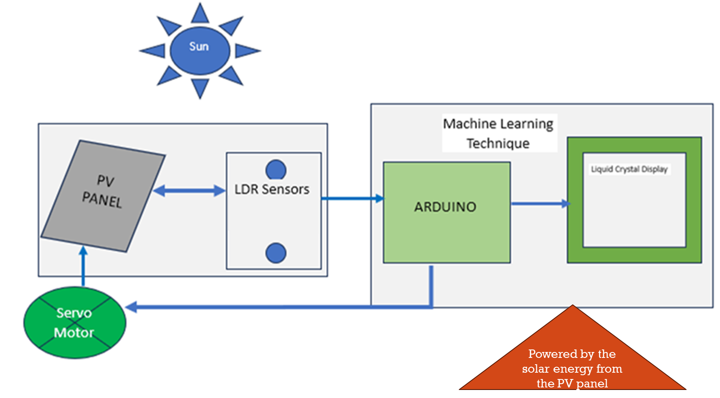
BLOCK DIAGRAM OF EMBEDDED SYSTEM

Slide 7
SELECTION OF EMBEDDED SYSTEM (Original equipement manufacturer)
Component Type | Qt | Unit Cost | Power Specifications |  |  | MCU
 |  |  | PW/DAY | Sleep mode Current | Active mode Current | RAM | ROM | Flash
Battery 9V | 1 | $2.80 | N/A | N/A | N/A | N/A | N/A | N/A
Resistor 10k | 2 | $9.9 | N/A | N/A | passive | N/A | N/A | N/A
Arduino NANO 33 BLE (32-bit ARM® Cortex®-M4 CPU) | 1 | $2.40 | 1200mA | 0 | 50mA | 256 kB | none | 1MB
LCD display | 1 | $0.9 | 12mA | 0 | 1mA | N/A | N/A | N/A
LDR | 2 | $2.56 | <6mA | 0 | <0.5mA | N/A | N/A | N/A
Jumpers | 1 | $14.39 | 6 mA | 0 | 0.05mA | N/A | N/A | N/A
Servo motor | 1 | $2.80 | N/A | N/A | N/A | N/A | N/A | N/A
Total |  | $45.36 | 1230mA | - | - | - | - | -

Slide 8
LAYERED SOFTWARE ARCHITECTURE
Edge Impulse, Arduio IDE
Software app
Middleware
Bluetooth Low Energy (BLE) Stack
Device Drive Layer I/O Layer (GPIO (A0, A1), PW
Hardware Abstraction Layer
Hardware Layer
Arduino nano, LCD, LDR Sensor, Servo Motor, PV

Slide 9
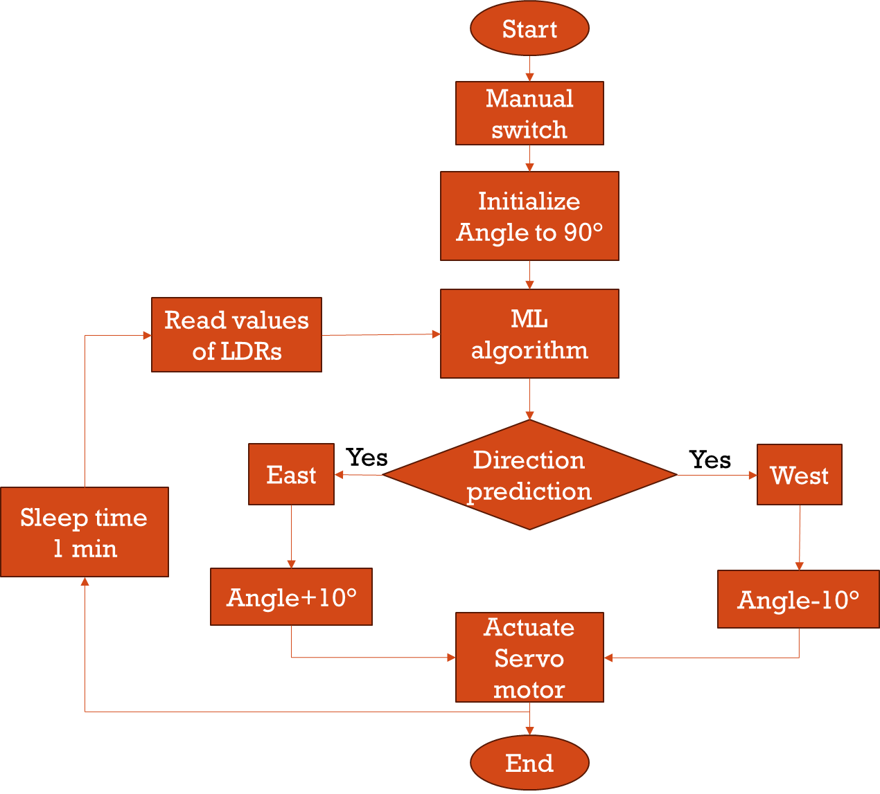
FLOW CHART

Slide 10
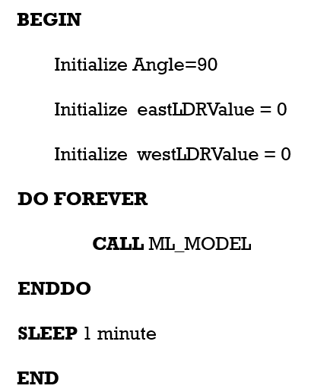
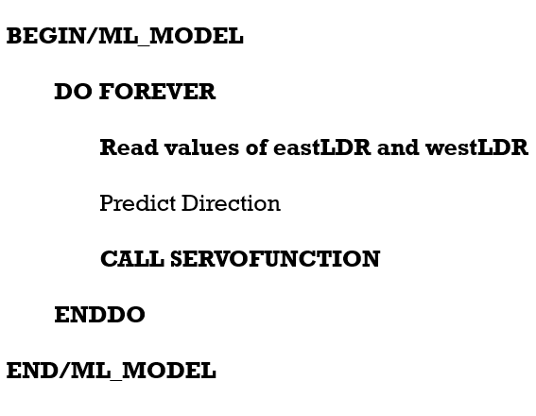
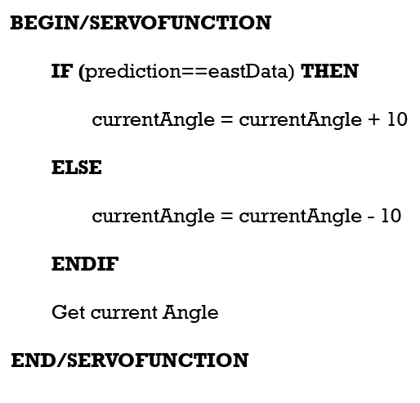
ALGORITHM DESIGN (PDL)

Slide 11
MACHINE LEARNING PIPELINE
Training and Validation
Training Set
Classifier
Performance Evaluation
Trained Model
Test prediction
Optimized Classifier
Collected Data
Converting to .tflite
Pre-processing & Labeling
Arduino Deployment
Testing
Set
Testing

Slide 12
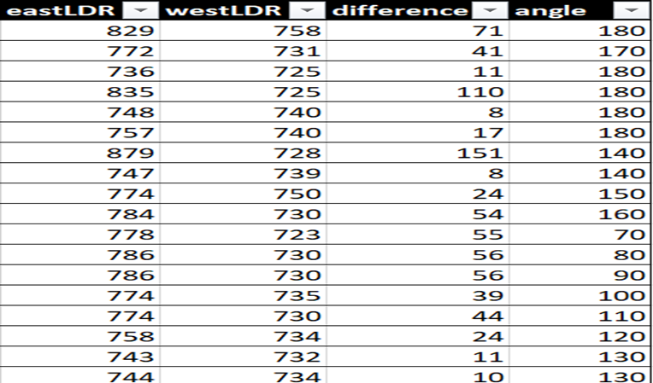
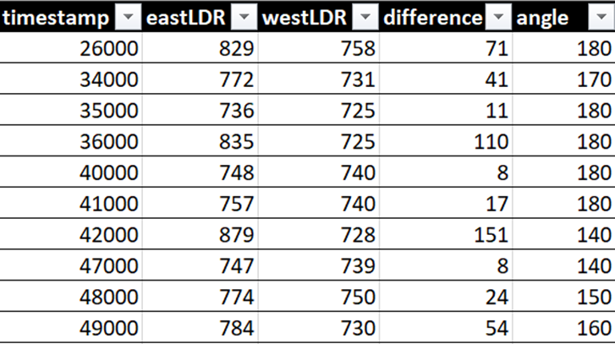
Data Collection :
•Input Variables :
•LDR values (East and West)
•Difference of the recorded variables
•Output Variable: Servo motor Angle
•Total number of data samples: 279
•Data format: csv
Data Preprocessing and Labelling
•Two output classes
•westData
•eastData
•Adding timestamp for EdgeImpulse Format
•Train test split: 80% Training, 20% testing

Slide 13
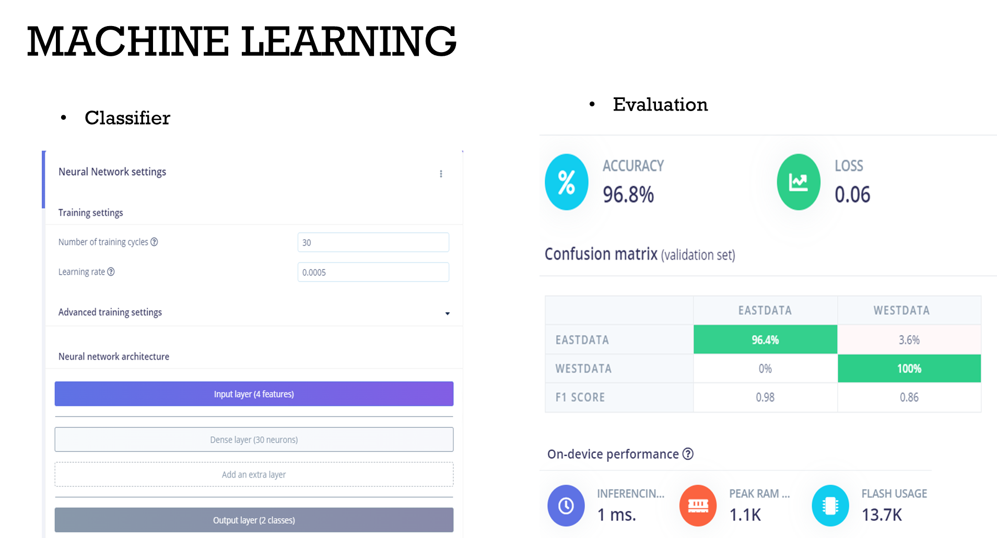

Slide 14
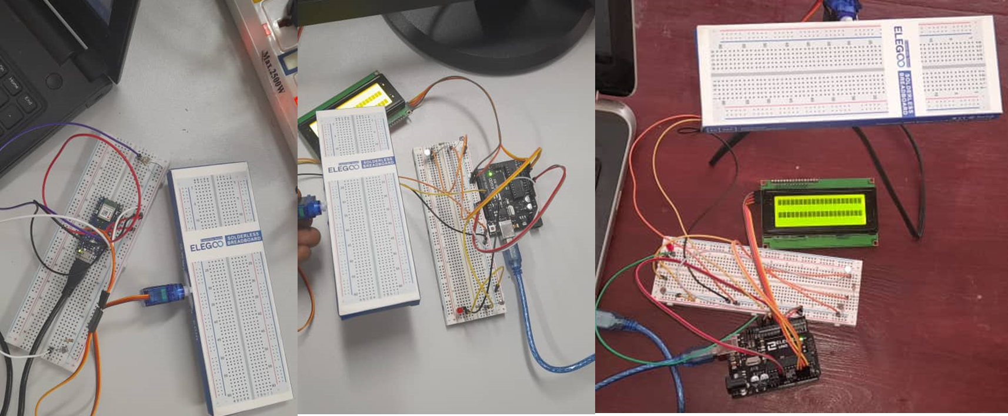
Rapid Prototype for Demo

Slide 15
Solar Energy Farming Sector:
Commercial and Industrial Sector:
Advantage of using solar trackers:
a. Increased Energy Production: Solar trackers allow solar panels to follow the sun's path, optimizing the angle of incidence for sunlight throughout the day. This results in higher energy output compared to fixed solar panels, typically ranging from 20% to 30% more electricity generation.
b. Improved ROI: With increased energy production, solar farm operators can achieve a quicker return on investment (ROI).
Advantage of using solar trackers:
a. Space Optimization: In the commercial and industrial sector, rooftop space is often limited, and businesses aim to maximize the solar energy output from their installations.
b. Cost Savings: By using solar trackers, commercial and industrial establishments can offset more of their electricity consumption from the grid. This results in cost savings on energy bills, especially in regions with high electricity rates.

Slide 16
CHALLENGES IN OUR PROJECT
The challenges encountered during the implementation include:
Unavailability of online data to train the model. The data used to train the model was generated from the solar system setup on Arduino Uno
Some of the components such as solar PV panel were not available but we improvised using a box to represent the panel
The energy produced by the Solar PV panel during the active and sleep mode could not be calculated

Slide 17
GITHUB LINK
https://github.com/rehema-HM/solar-tracker

Slide 18
Thank you!

